Slide 1
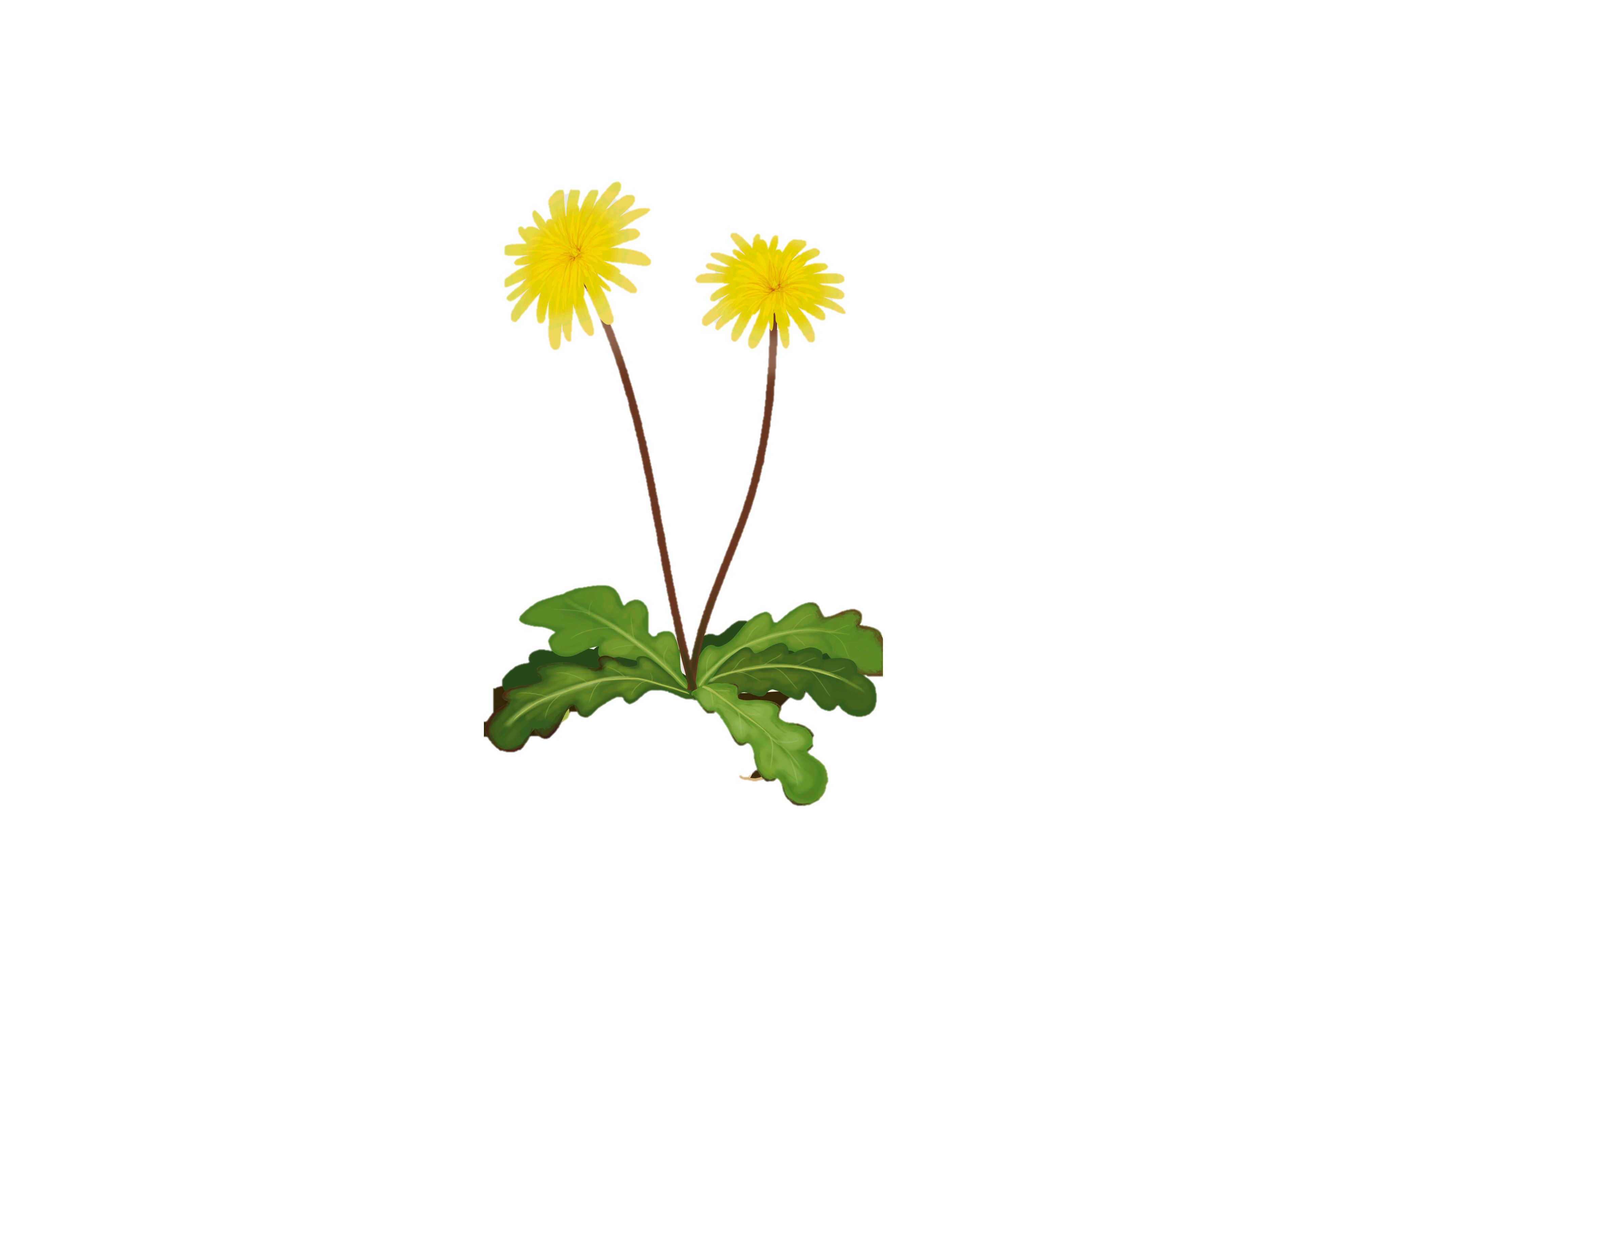
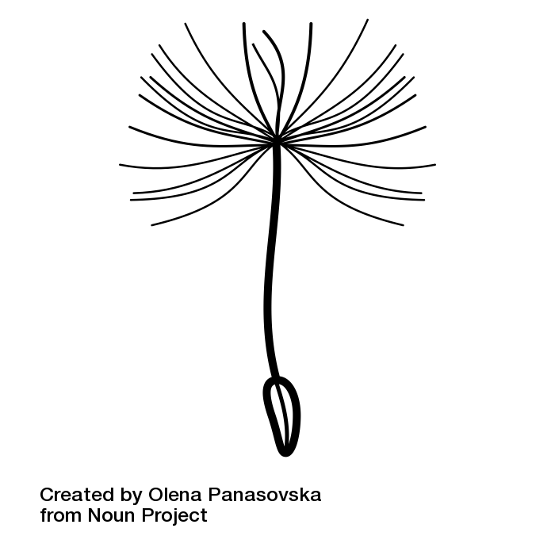

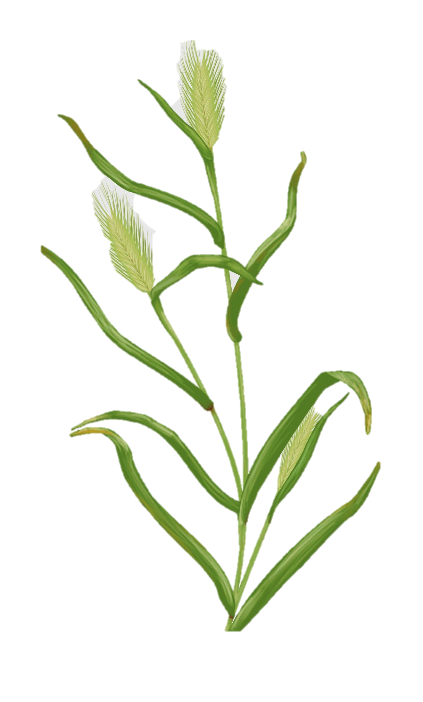
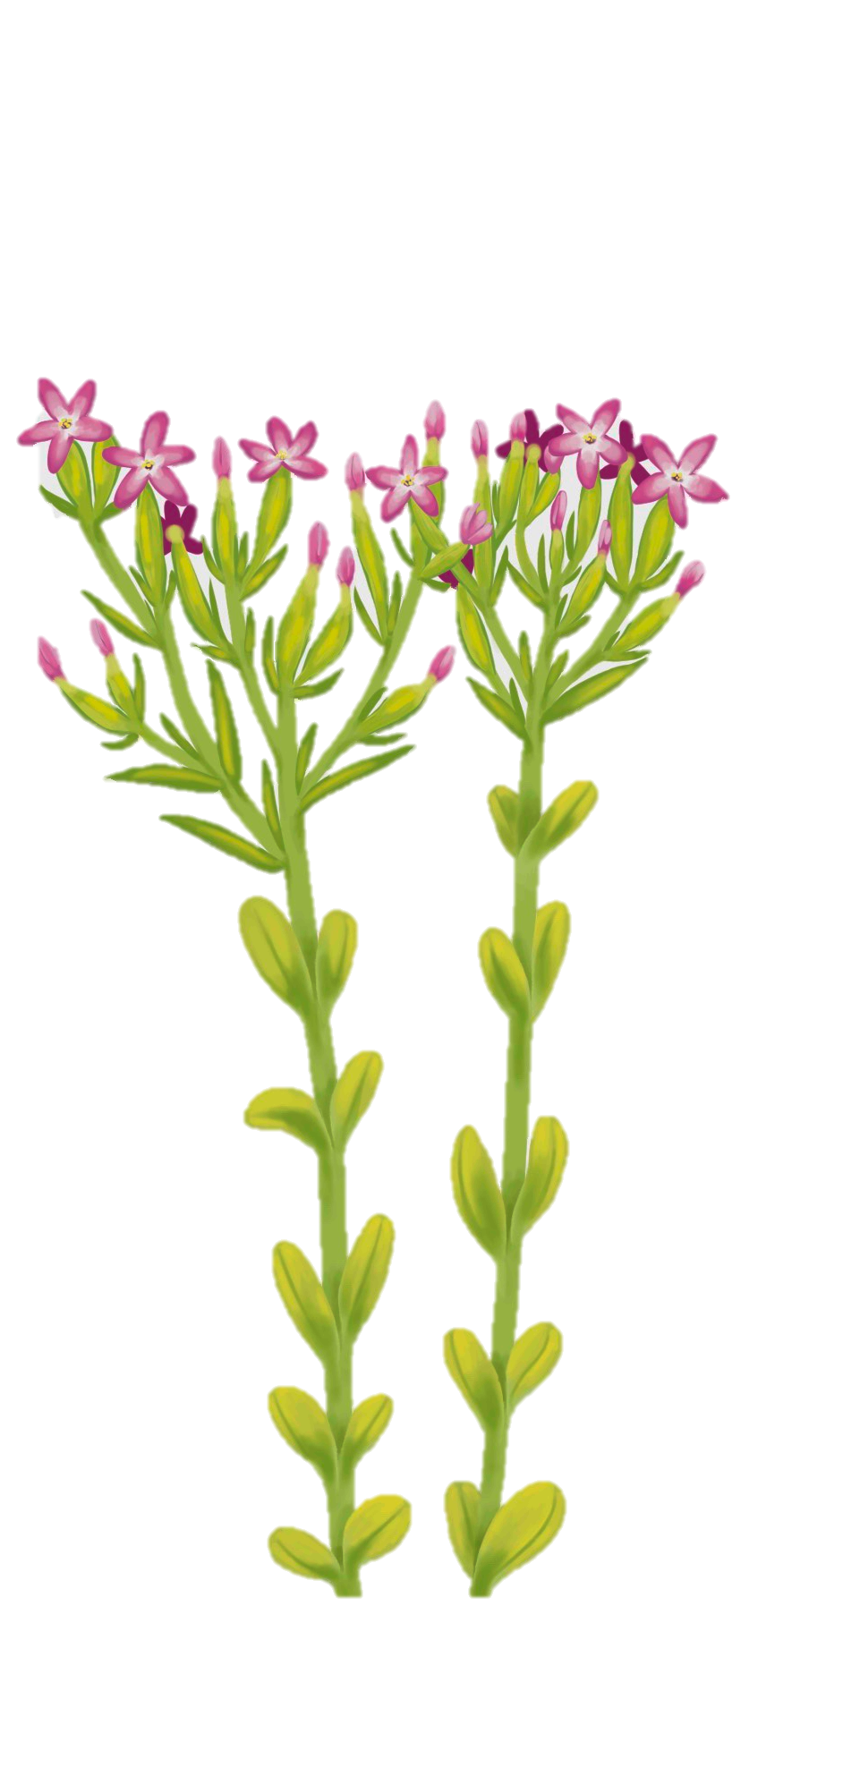
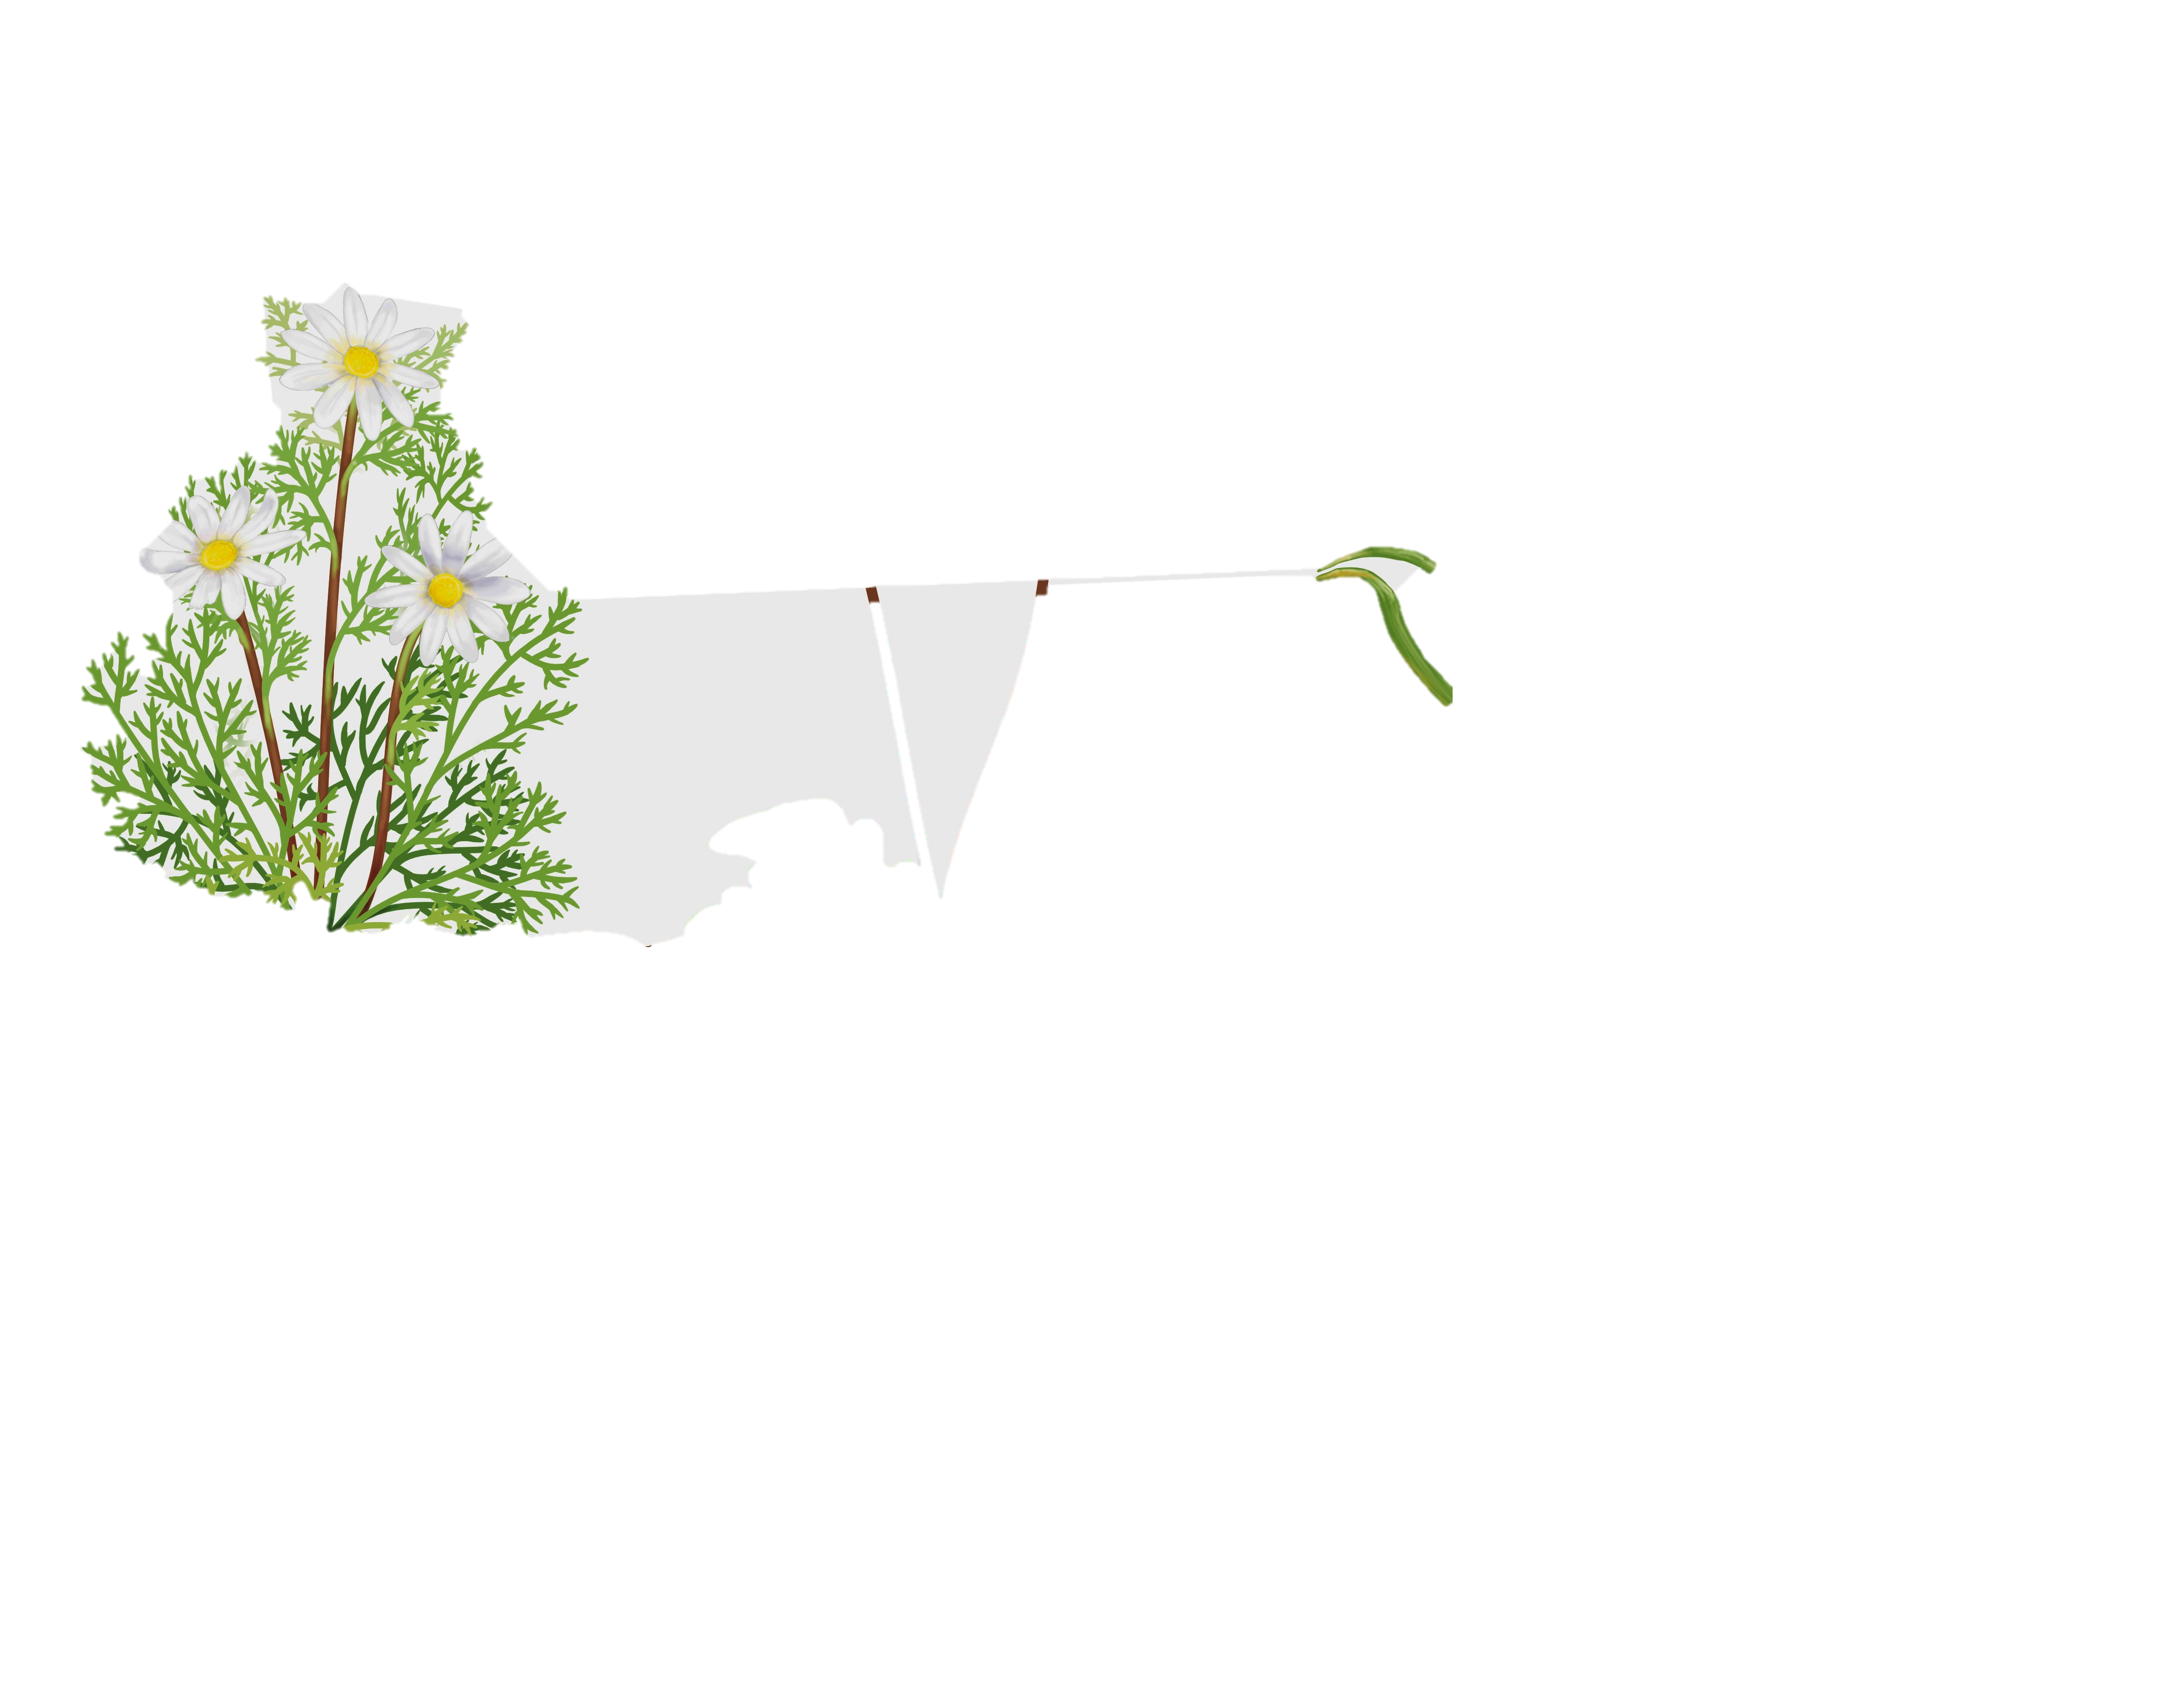

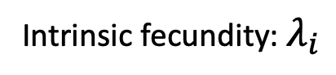
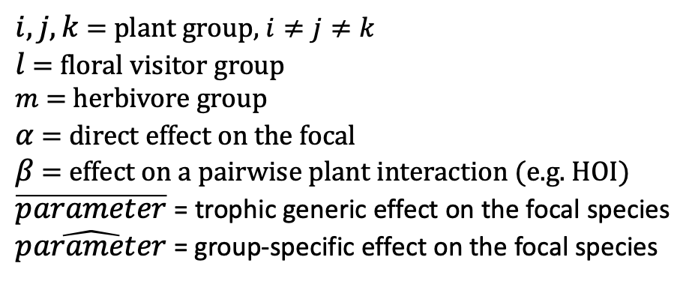
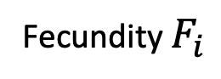
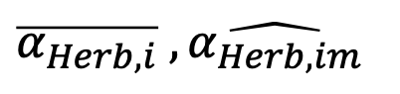

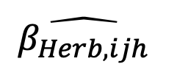
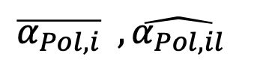
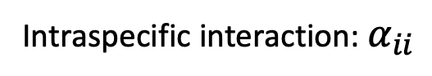
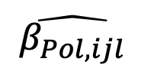
Intrinsic fecundity: $λ_{i}$
Self-regulation
Intraspecific interaction: $α_{ii}$
Fecundity $F_{i}$
Pollinator
$$\overline{α_{Pol,i}} , \hat{α_{Pol,il}}$$
$$\hat{β_{Pol,ijl}}$$
Within and across
trophic levels effect
$$\overline{α_{i}} , \hat{α_{ij}}, \hat{ β_{i,Plt,jk}}$$
Plant
$i, j, k$ = plant group, $i≠j≠k$
$l$ = floral visitor group
$m$ = herbivore group
$α$ = direct effect on the focal
$β$ = effect on a pairwise plant interaction (e.g. HOI)
$\overline{parameter}$ = trophic generic effect on the focal species
$\hat{parameter}$ = group-specific effect on the focal species
$$\hat{β_{Herb,ijh}}$$
Herbivore
$$\overline{α_{Herb,i}} , \hat{α_{Herb,im}}$$

Slide 2
Negative (-)
Positive (+)

Slide 3
Positive (+)
Negative (-)

